Slide 1
welcome

Slide 2

Presented by:
Toushee Jotirmoyee Biswas
20221129010
Nishat Mustary
20221127010
Ayan Tasmim Shaity
20221132010
Tanha Ferdousi
20221160010
Department: CSE
Section: D
Presented to:
Jannatul Fredous Asha
Adjunct Lecturer
Dept of CSE, NWU

Slide 3

Inner meaning of Paulo Coelho’s
The Alchemist

Slide 4
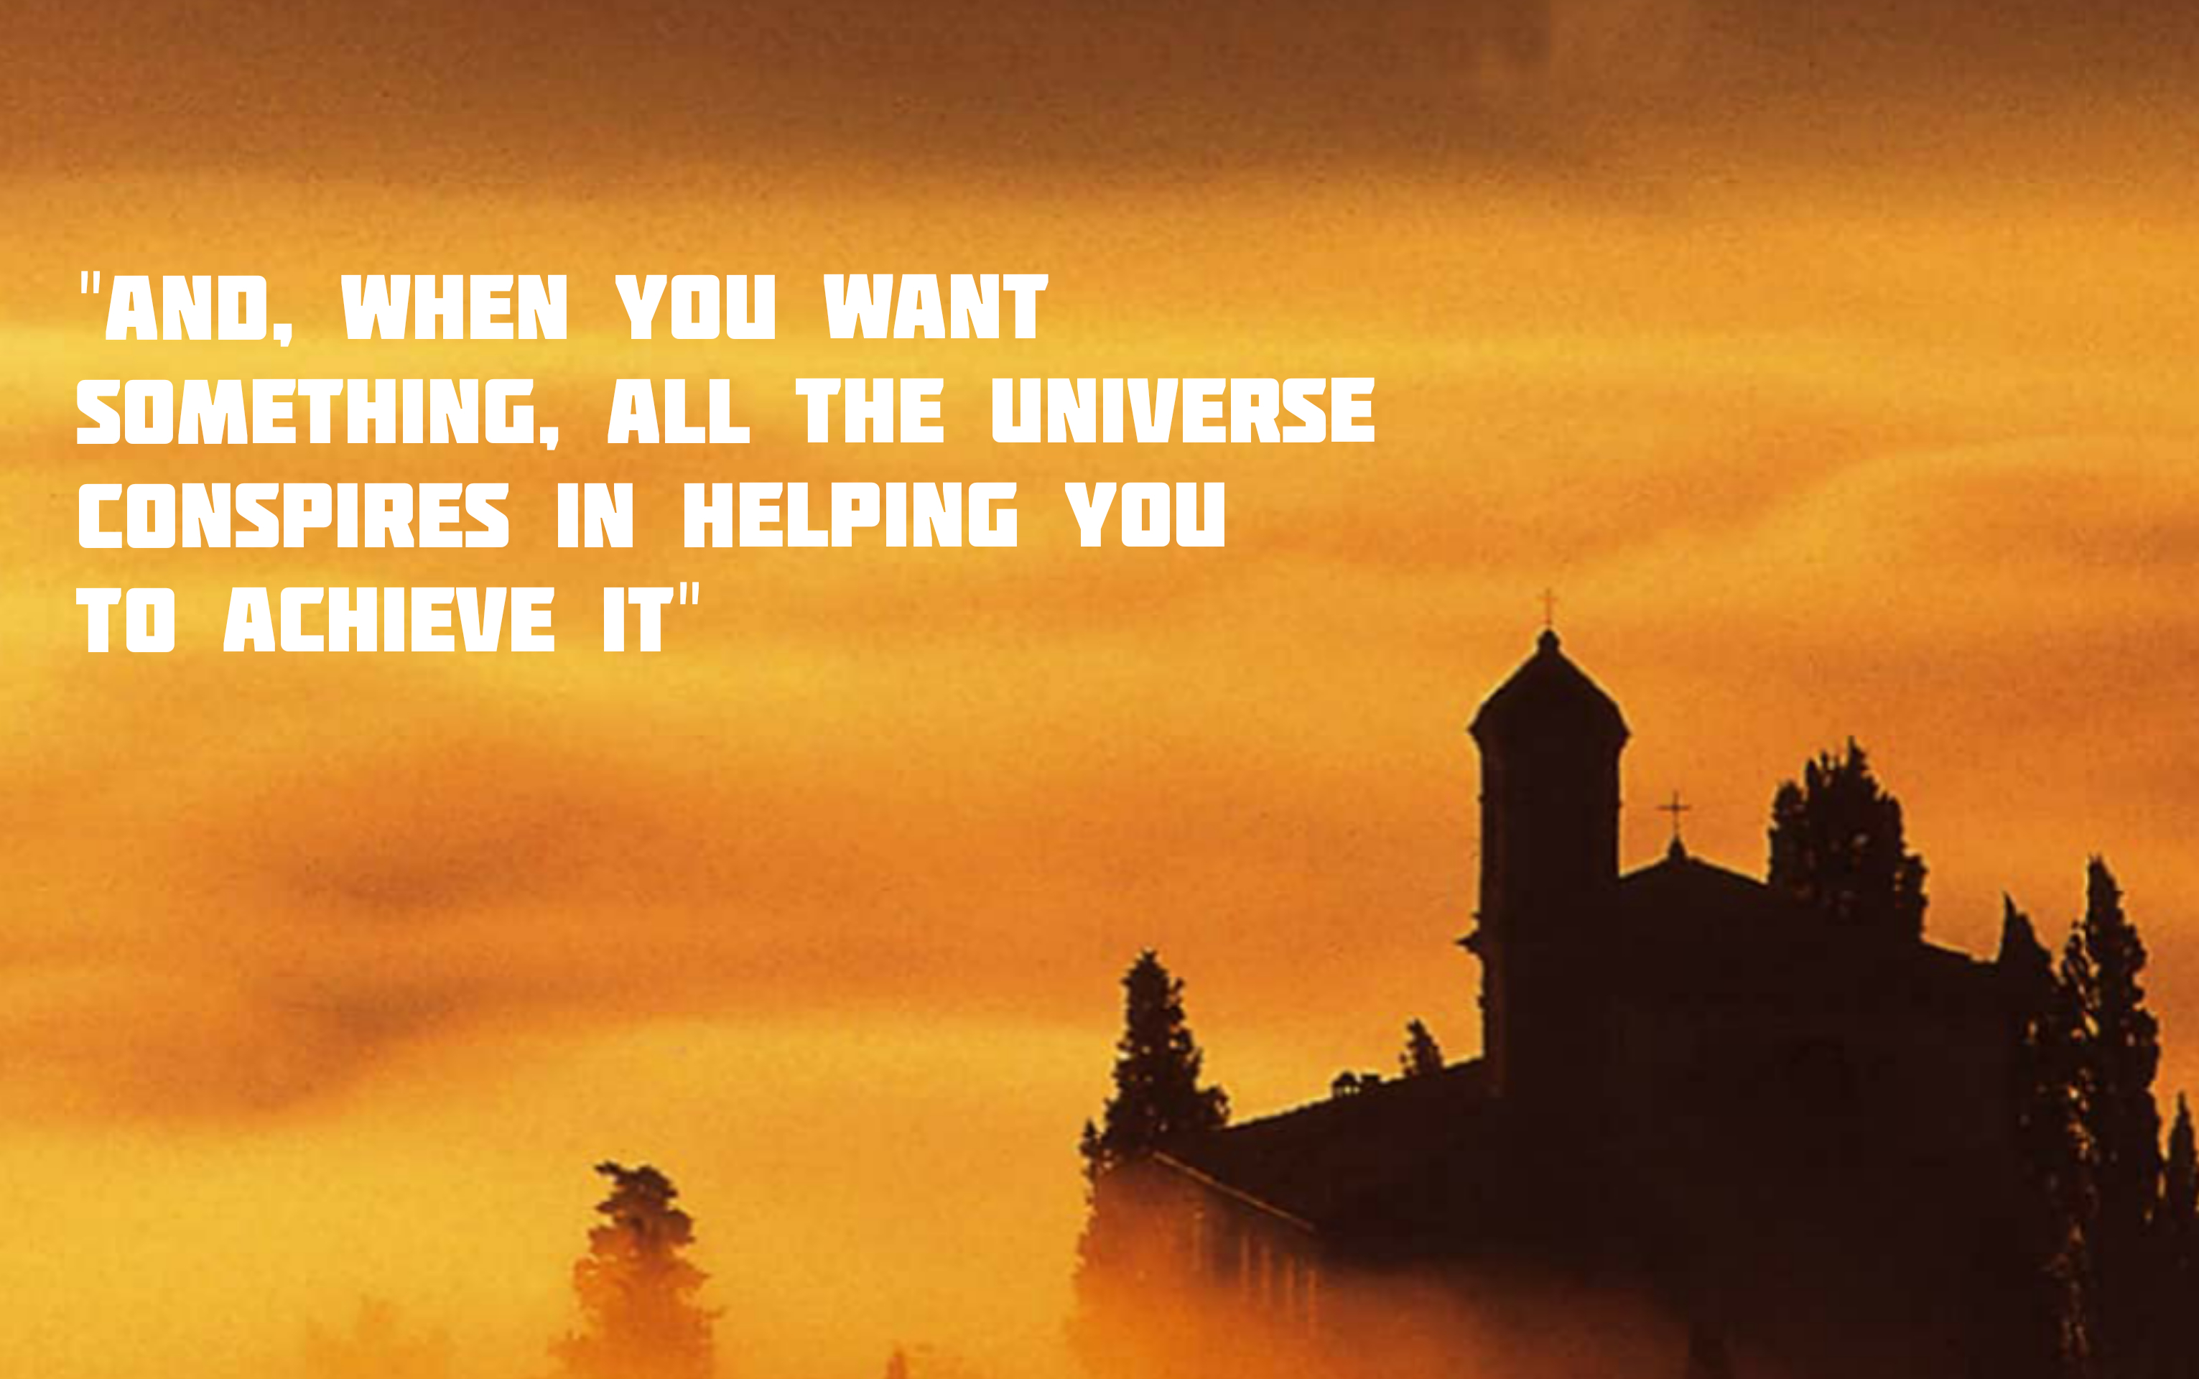

Slide 5
1. When we want something in life, then it’s our responsibility to get up and do something about it. Too often in life, we let fate decide our day to day actions and hope all too much that things will work out in the end.
2. But if you think big, listen to your heart and dedicate your life to achieving whatever it may be, the universe will always reward you with attainment.
3. But know this, you will fail. Failure is a part of the process. As when you work out and lift weights, it is the failure that makes it possible for you to grow. You have to be broken down in order get back up stronger.

Slide 6
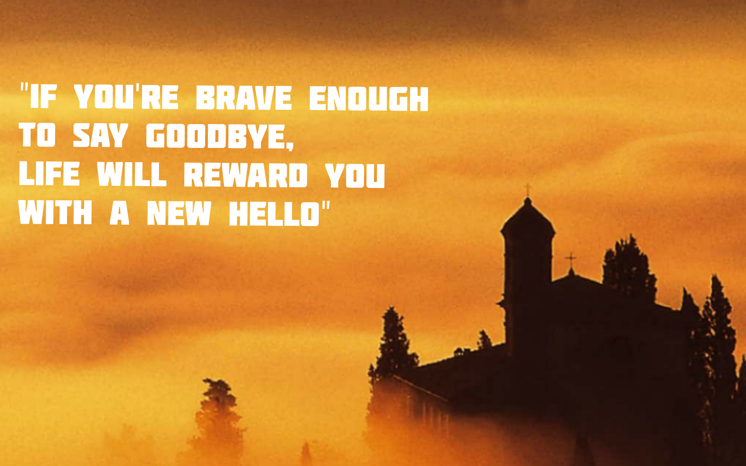

Slide 7

1. It is very important to understand that life is actually a continuous flow of events. Our life is actually made up of time and memories. These memories are actually beautiful experience which may be good or bad.
2. Sometimes life gives us lemons so that we can make lemonade from them. We need to learn from our bad experiences and Correct them in the present time.
3. It becomes necessary to accept failures and disappointment. When one door opportunity closes, another door opens to unlock all our dreams and happiness. The only thing which is important to do is to live life with a smile one our face.
.

Slide 8
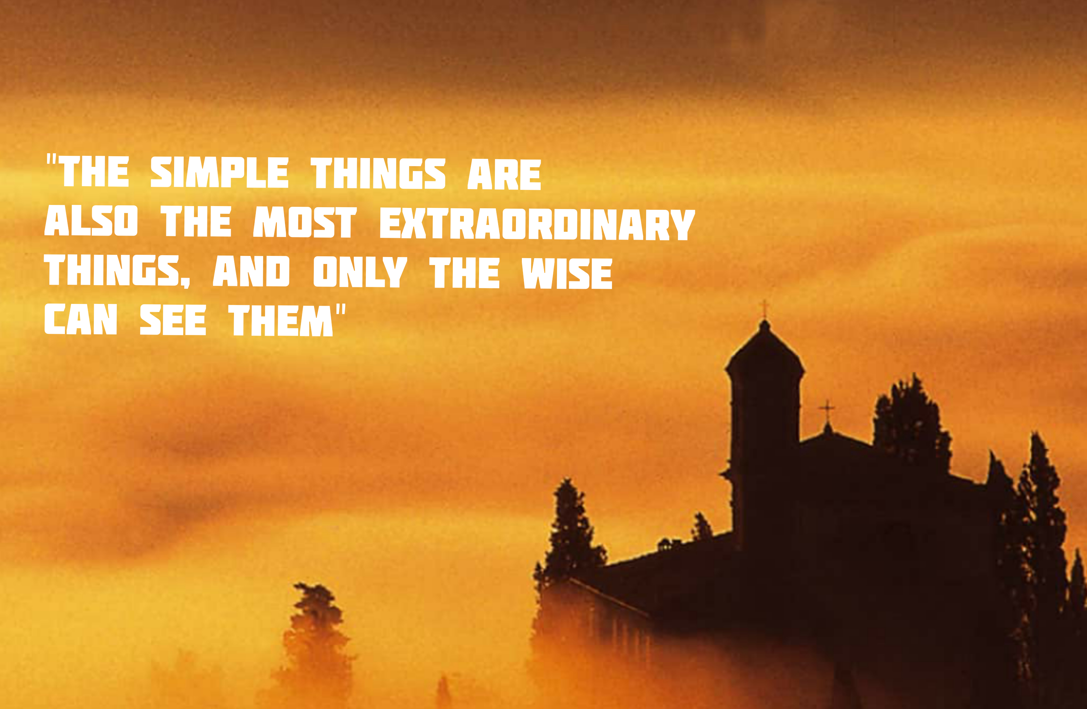

Slide 9
1. For being different is being yourself, it is the realization that you are your own unique you. To be different is to realize that your personal legend is yours and yours only.
2. You are you. This makes you unique, as nobody else has your experiences. Nobody else is you and that is your power.
3. Be inspired to be different. Dare to be different. Do not let the fear of others opinions dictate your actions. This life to live is yours.
4. Pursue your dreams, passionately, and with your heart. Live the life that you want to live, work the job that you want work, and don’t let anyone knock you off of your own path. As the key to happiness is the satisfaction of being able to do all that you love doing.

Slide 10
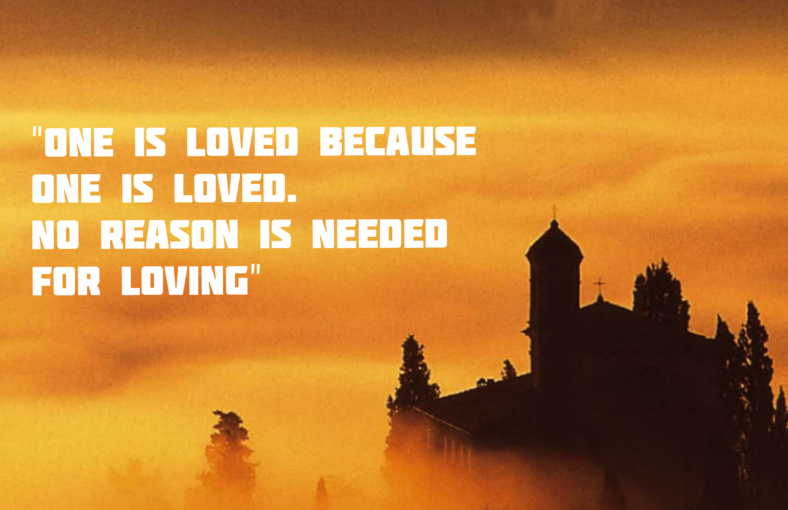

Slide 11
No reason is needed for loving. When you love someone there isn’t any reason behind it. We are born with the idea installed in our system to love another
Our first love is our mother. We don’t love her for any reason. We “just” love our mothers. Love is a simple, intuitive emotion–when you love someone, you just know it, and you don’t need a reason.
Never look for a reason why someone loves you, love doesn’t start with a reason it starts with feelings.
The reason you should never love someone for any particular reason is. If that reason is no longer existence then love also won’t exist
5. I want to leave you guys with a thought, next time when someone says they love you, don’t look for a reason. Embrace it cherish it. Accept the love and return the love.

